Slide 1



Basic Text Mining and Sentiment Analysis
Presenter: Wenxiao Zhou
Department of Statistics, University of Connecticut

Slide 2


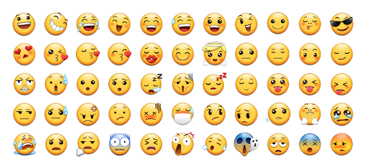
Inspiration
Once you are listening to a music, or watching a movie:
Happy or Sad? Love or Hate?
Hopeful or Despair?
Passionate or Indifferent?
Can any of the emojis below represent your emotion?

Slide 3

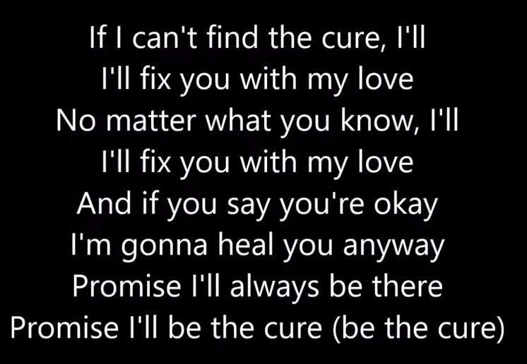
Listen to a song: The Cure -- Lady Gaga
Music in general is positive, encouraging and healing.
Question: How can computer detect emotions like human???

Slide 4

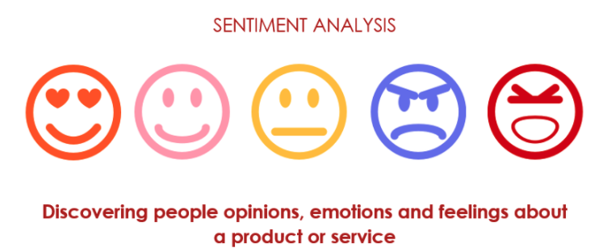
Sentiment Analysis:
A process extracting an author’s emotional intent from text.
It is a natural language processing (NLP) technique used to determine whether data is positive, negative or neutral.

Slide 5
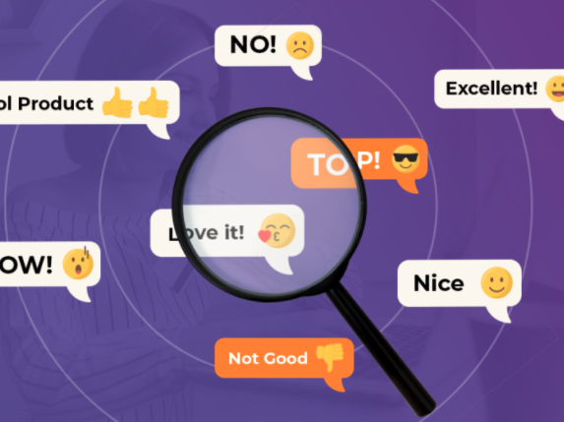
Why is Sentiment Analysis Important?
There are many apps setting comments platforms for their customers to make reviews, sentiment analysis helps to monitor and automatically analyzing customer feedback.

Slide 6



1. Detect the texts and break it into tidy format components
Recall our Question:
How can computer detect emotions like human???
2. Make comparison with lexicons, assign sentiment score
3. Combine scores and data visualization

Slide 7
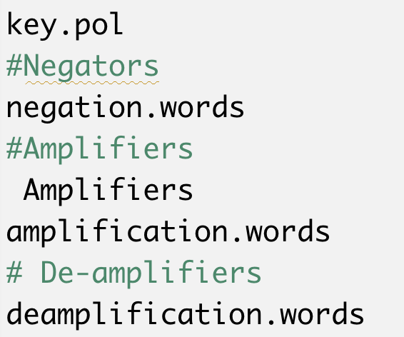
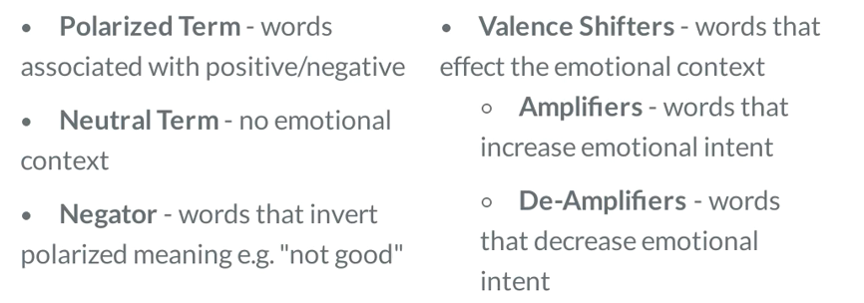
Fast & Dirty Analysis: qdap library, polarity function
polarity():
Use an academic lexicon from the University of Illinois-Chicago.
It contains almost 7000 words marked as positive or negative.

Slide 8
Note:
Remember to download Java to support qdap package first, find the version for your computer in the link below:
https://www.oracle.com/java/technologies/javase-jdk15-downloads.html
To check you can use qdap package by the following codes:
install.package(“qdap”)
Install.package(“rJava”)
library(qdap)
library(rJava)
help(polarity)

Slide 9
Example Titanic is a very great movie.
Term | Class | Word Count | Polarity Value
Very | Amplifier | 1 | 0.8
great | Polarized Term/Positive | 1 | 1
All other words | Neutral | 5 | 0
Polarity calculation:
1+0.8=1.8
1+1+5=7
Polarity score=1.8/sqrt(7)=0.6803

Slide 10

Question:
How can subjectivity lexicons handle various types of human emotions ?
Two principals:
1. Zipf' Law
2. The Principle of least efforts
Even though two principals can make it logically use subjectivity lexicons, you will still need to adjust lexicons to fit the text source under certain environments, e.g. different age groups may have special words represents emotions.

Slide 11
Have a Try!!!
Let’s go back to our Lyrics Analysis on ”The Cure”
A fast & Dirty Sentiment Analysis in R
More interesting!!!
Advanced lyrics analysis on Taylor Swifts songs

Slide 12
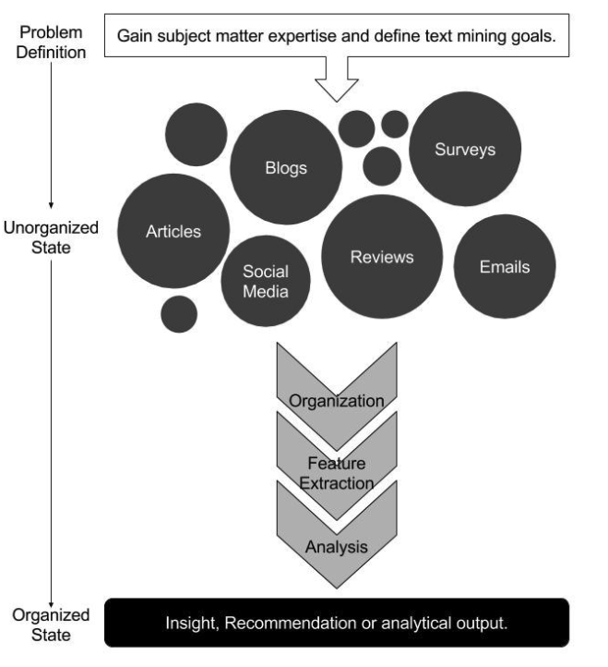
Go Further: What if we are interested in analyzing the emotions of customers’ comments in one platform?
Text Mining Workflow

Slide 13
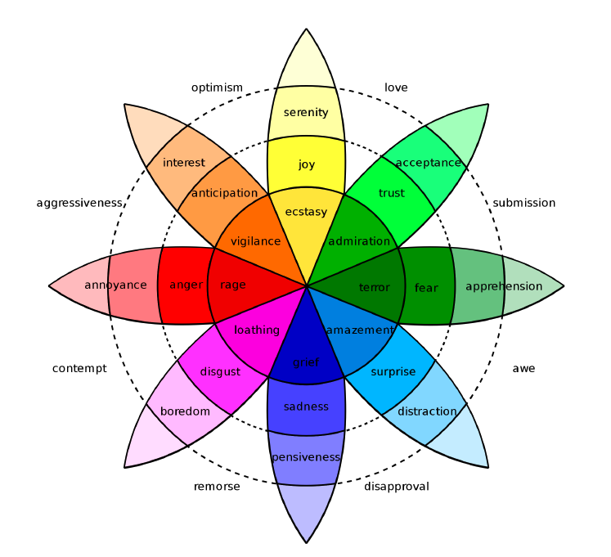
Plutchik’s Wheel of Emotion
Visualization consisting of eight primary emotions including joy, trust, fear, surprise, sadness, disgust, anger, anticipation.

Slide 14
Common Subjectivity Lexicons & Inner Join
Bing Lexicon & inner join
AFINN Lexicon
NRC Lexicon

Slide 15
dplyr package join inner_join(x,y,…) left_join(x,y,…) right_join(x,y,…) semi_join(x,y,…) anti_join(x,y,…) declaring the by parameter: inner_join(x,y,by=“shared_column) or inner_join(x,y,by=c(“a”=“b”))
inner join

Slide 16
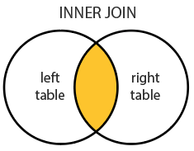
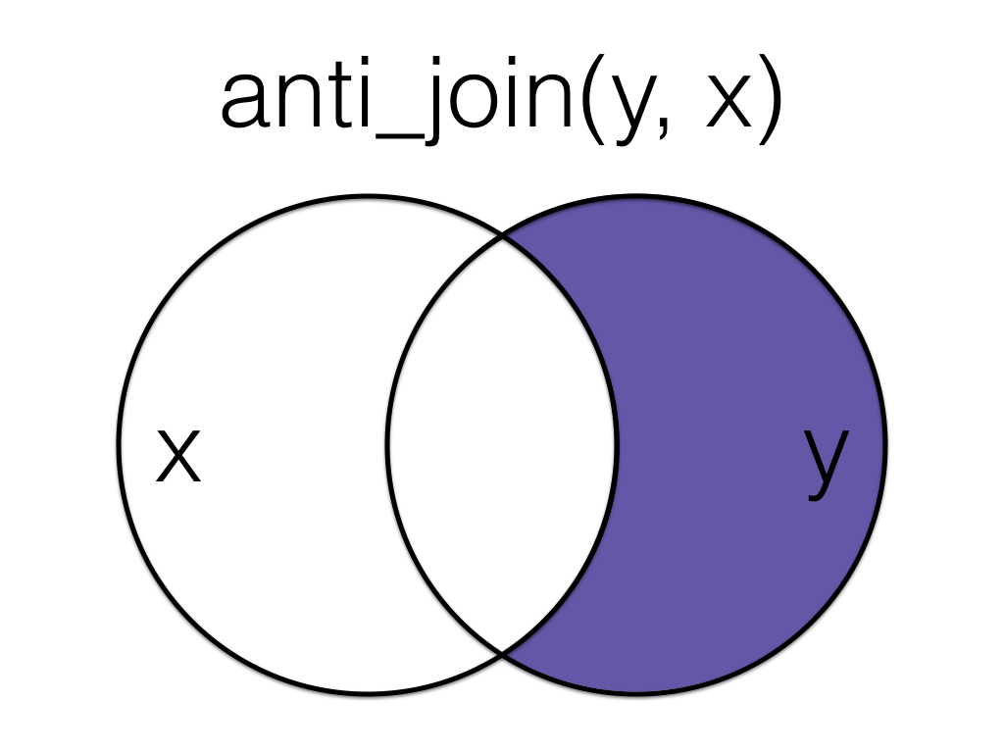
Comparing inner join and anti joins
inner_join(
text_table,
subjectivity_lexicon,
by=“word_column”
)
anti_join(
text_table,
stopwords_table,
by=“word_column”
)

Slide 17
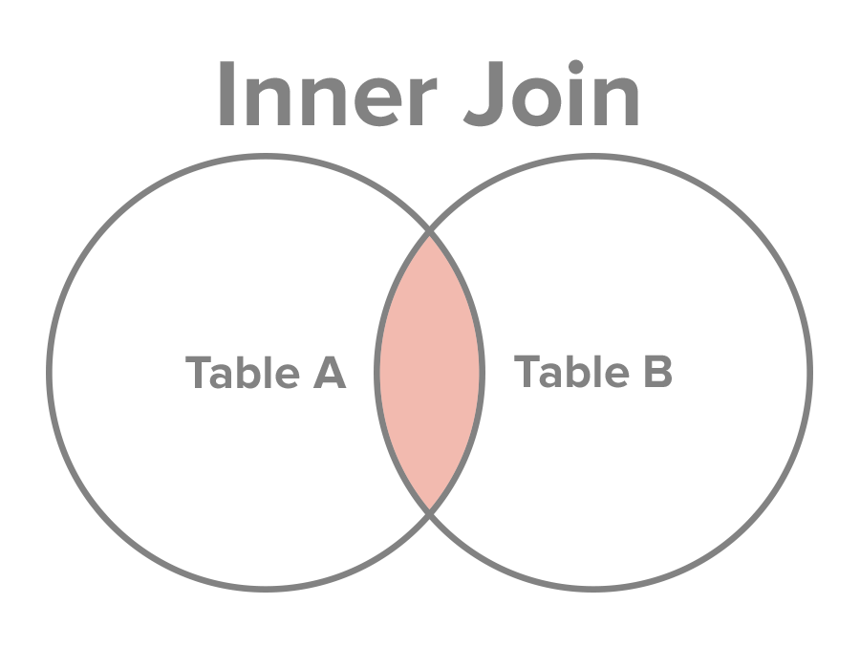
In our case Inner join Texts with positive/negative words
Positive/Negative words Table
Text Table

Slide 18

Basic Introduction:
The NRC lexicon categorizes words in a binary fashion (“yes”/“no”) into categories of positive, negative, anger, anticipation, disgust, fear, joy, sadness, surprise, and trust.
The BING lexicon categorizes words in a binary fashion into positive and negative categories.
The AFINN lexicon assigns words with a score that runs between -5 and 5, with negative scores indicating negative sentiment and positive scores indicating positive sentiment.
library(tidytext)
library(textdata)
get_sentiments(“afinn”)
get_sentiments(“nrc”)
get_sentiments(“bing”)

Slide 19
Recall: Text Mining Workflow
Six Steps:
Define the Problem & Specific Goals
Identify the text
Organize the text
Extract features
Analyze
Draw a conclusion/ reach an insight

Slide 20
Have a Try!!!
Let’s go to our advanced case study
Airbnb Reviews Sentiment Analysis in R

Slide 21

Summary
qdap package, polarity() function
Text Mining workflow & Basic Text cleaning
Subjectivity lexicons & Inner join
Two Cases Study
Data and Codes download:
https://github.com/WenxiaoZhou/My-projects/tree/main/Text%20Mining%20and%20Sentiment%20Analysis

Slide 22
References
1. KWARTLER, E. (Ed.). (n.d.). Text Mining with Bag-of-Words in R. (website)
https://learn.datacamp.com/courses/intro-to-text-mining-bag-of-words
2. Tatman, R. (2017, September 15). Tutorial: Sentiment analysis in r. (website)
https://www.kaggle.com/rtatman/tutorial-sentiment-analysis-in-r
3. Silge, J., & Robinson, D. (2017). Text mining with R: A tidy approach. Sebastopol, CA: O’Reilly
https://www.tidytextmining.com/index.html

Slide 23
Welcome to contact me: Email: wenxiao.zhou@uconn.edu Linkedin: linkedin.com/in/wenxiao-christine-zhou
Thank you for listening!!!

